Slide 1

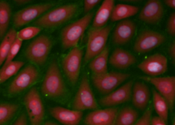
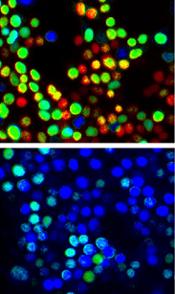
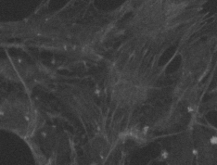
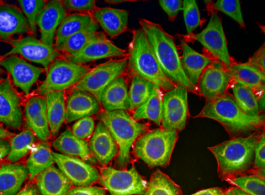
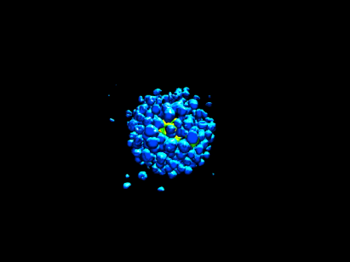
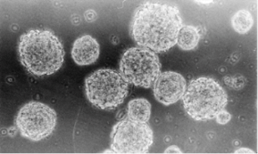
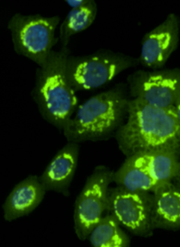
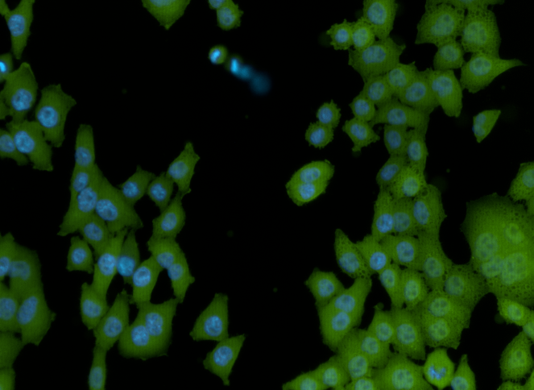
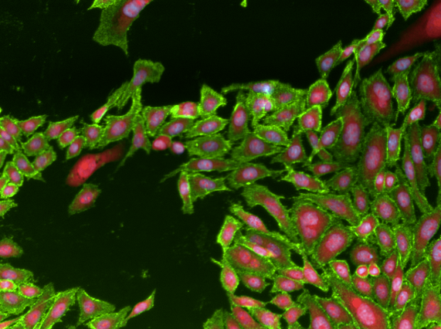
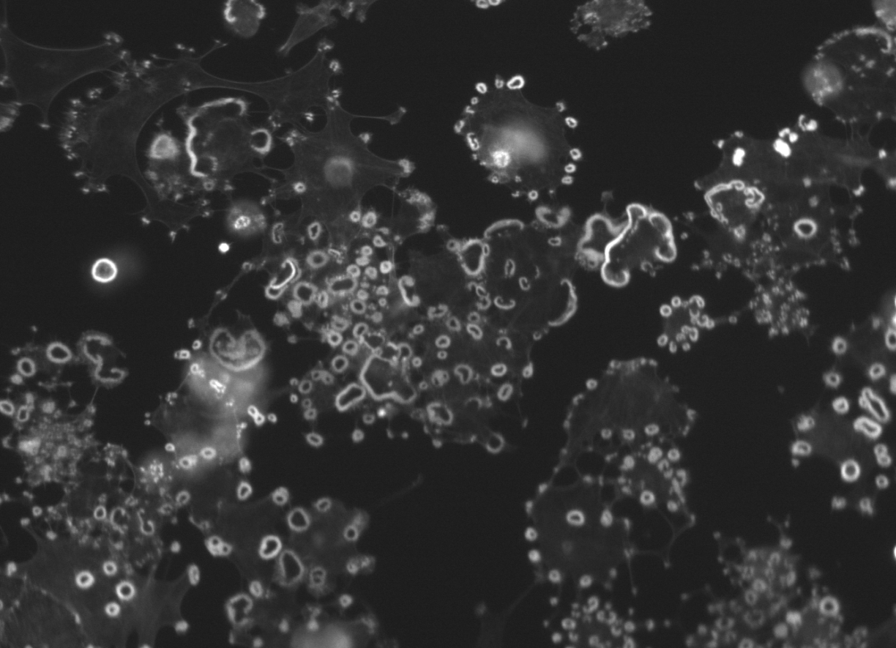
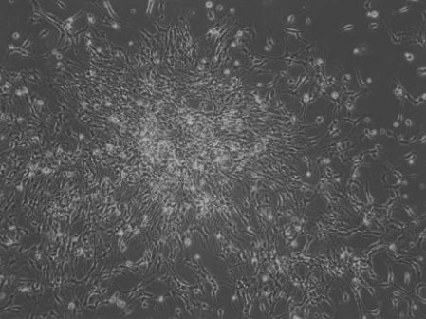
Cell Differentiation
April 30, 2018 Ginny Wu
CDW Tutorials 2017, La Jolla, CA
Notes:
X1, y1, x2, y2

Slide 2
Biology
Cells used for various drug assays develop differently in reaction to the substance
High Content Imaging (HCI) platforms can be used to generate this phenotypic data on the cells used in assays.
Problem: How can the definitive data be efficiently collected from the images?
CDW Tutorials 2017, La Jolla, CA

Slide 3
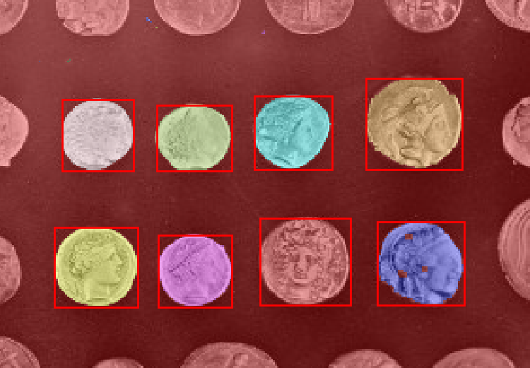
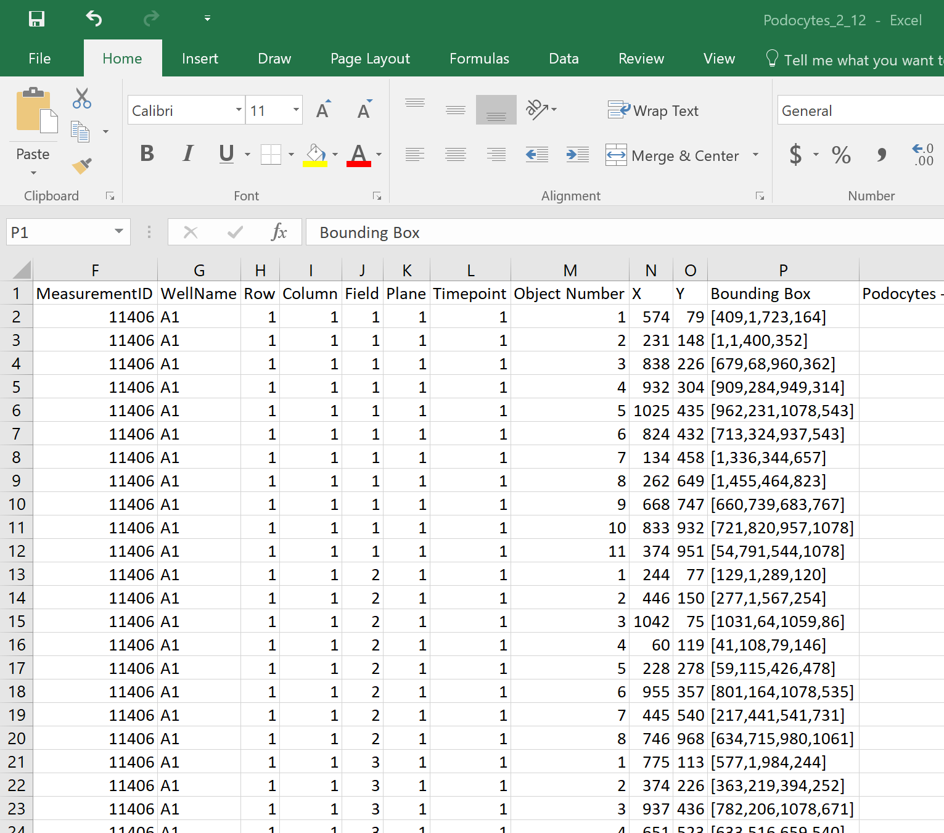
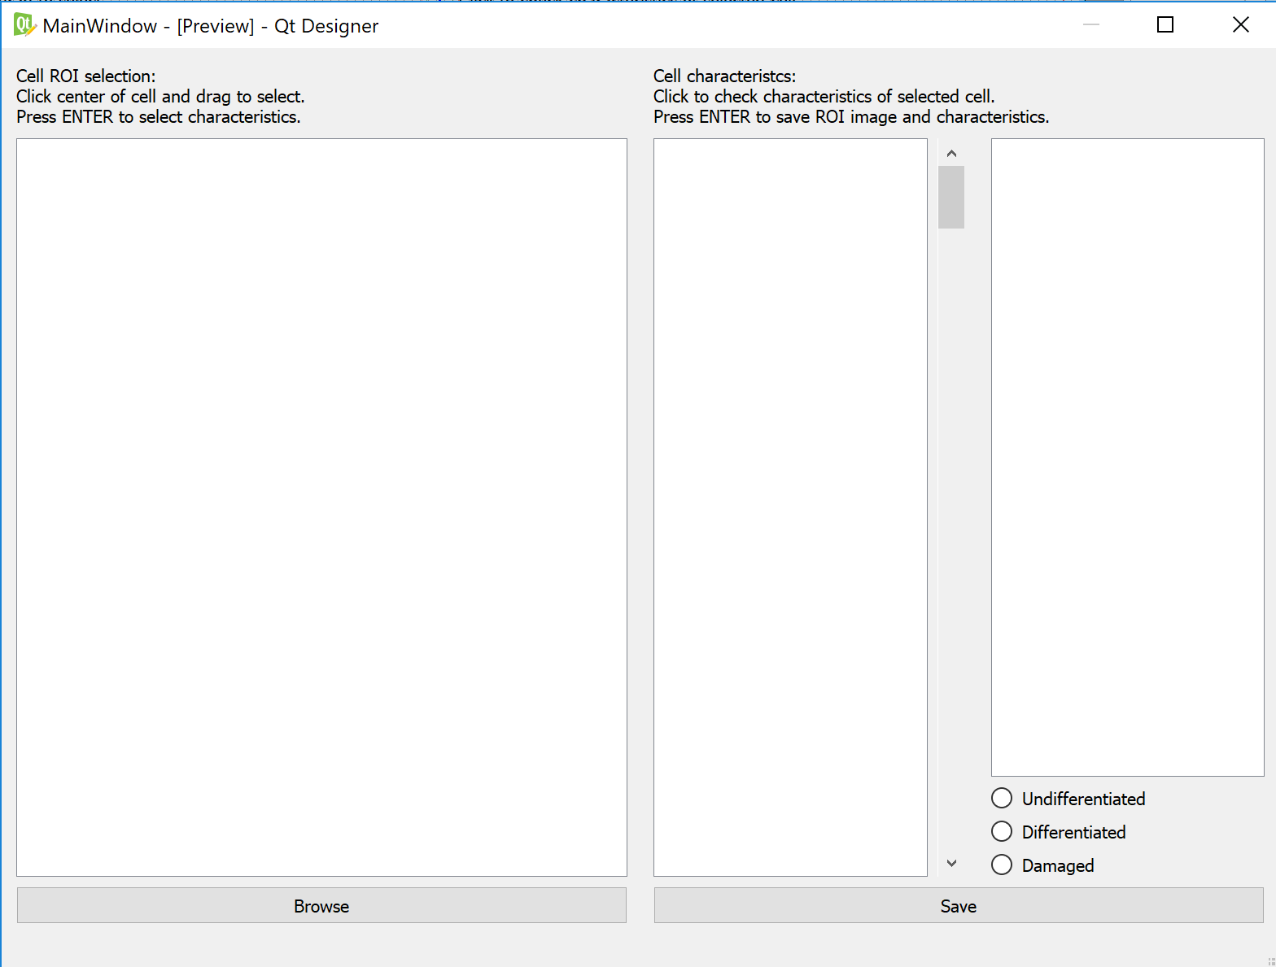
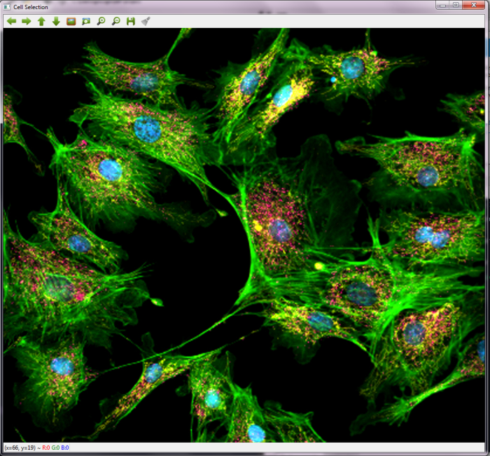
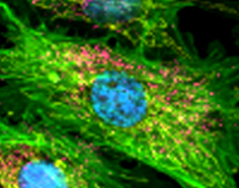
Approaches
Final Method
Scikit Image
Excel sheet
OpenCV with GUI
CDW Tutorials 2017, La Jolla, CA

Slide 4
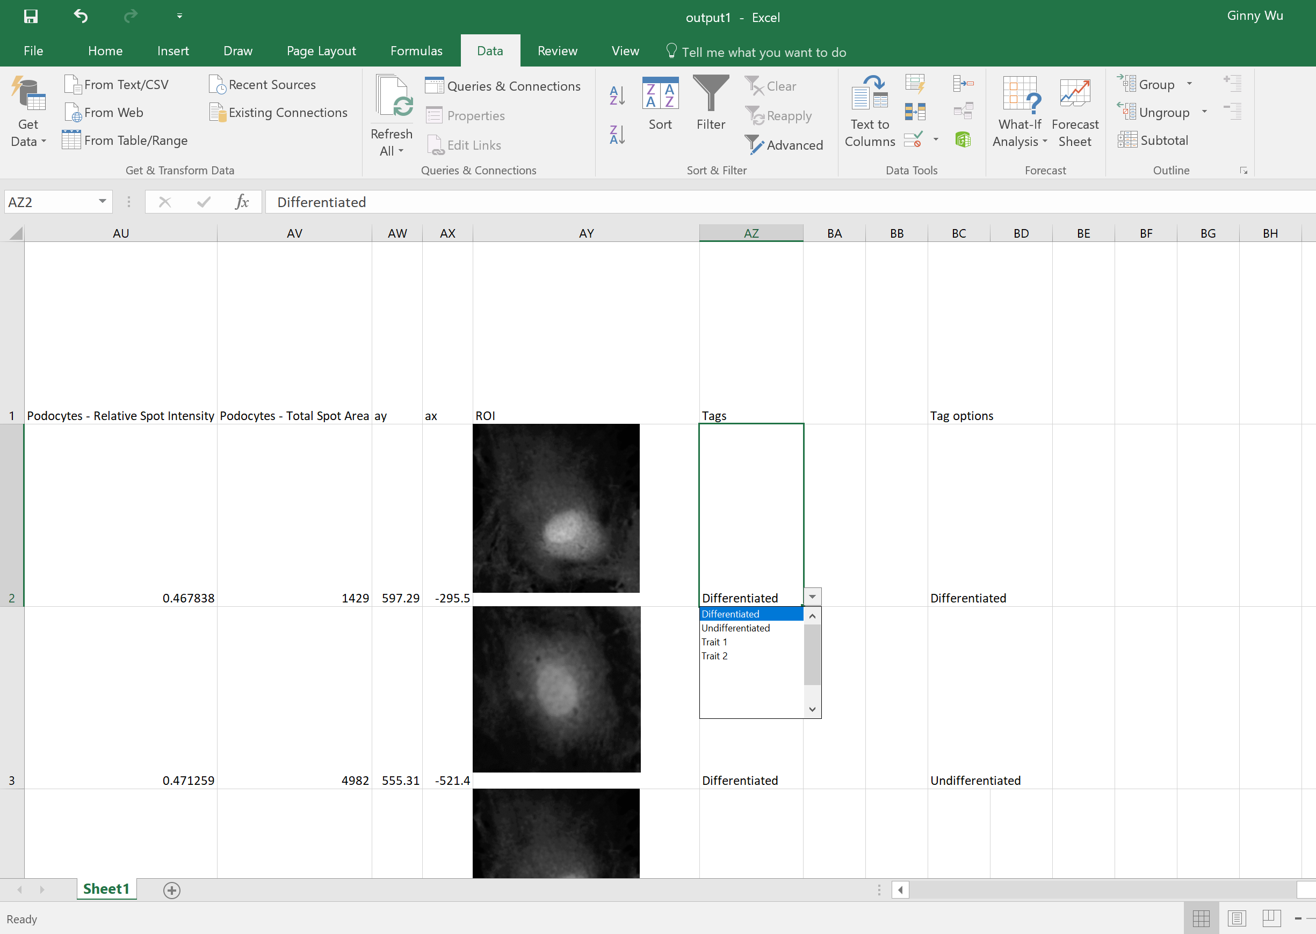
Demo
Cell_image.py
CDW Tutorials 2017, La Jolla, CA

Slide 5
Future Development
Image adjustment
Exposure
RGB
GUI Interface
Ease of use
Outputs images to new folder (or Excel)
CDW Tutorials 2017, La Jolla, CA

Slide 6


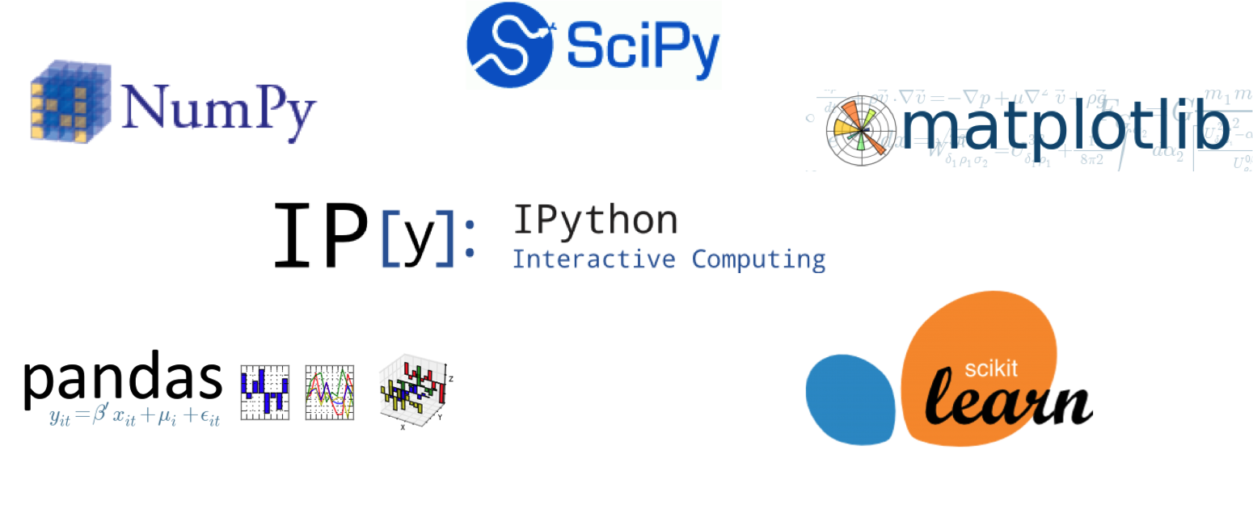
Experience
Anaconda platform
Basic Python syntax
Common packages
OpenCV, Pillow
GUI
Tkinter
QtPy5
Xlsxwriter
CDW Tutorials 2017, La Jolla, CA

Slide 7
Bugs
Showing images
.tif files are autoformatted for insert in Excel
Opening .tif files with Opencv results in B&W picture
Opening .tif files with matplotlib.py
Full color image only shows in terminal
But only after terminating run?
CDW Tutorials 2017, La Jolla, CA

